Slide 1
Digital Input and Output
By Kunchala Anil

Slide 2
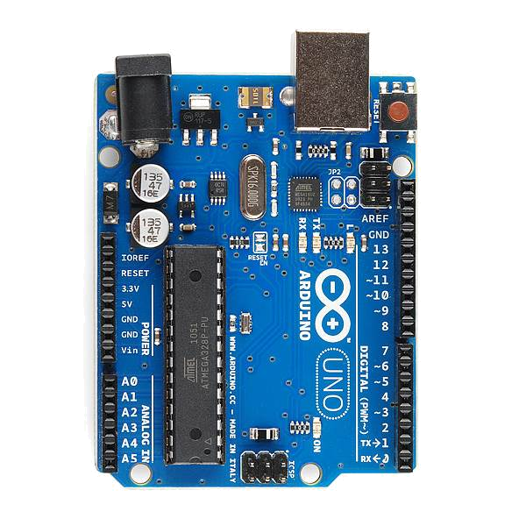
Board Overview
PWR IN
USB
(to Computer)
RESET
SCL\SDA
(I2C Bus)
POWER
5V / 3.3V / GND
Digital I\O
PWM(3, 5, 6, 9, 10, 11)
Analog INPUTS

Slide 3
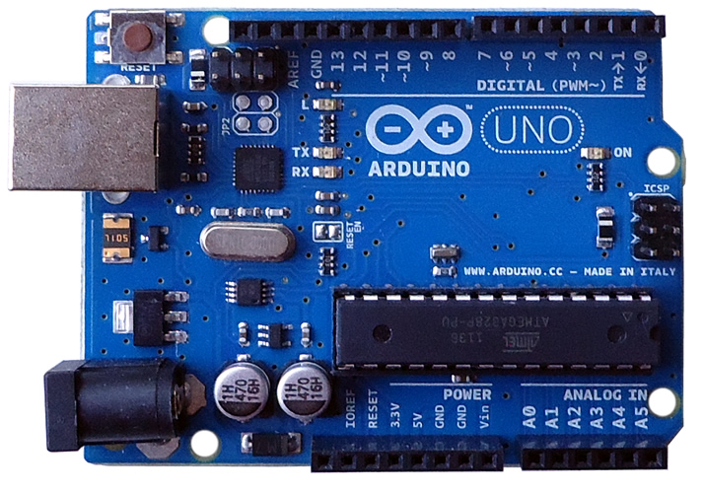

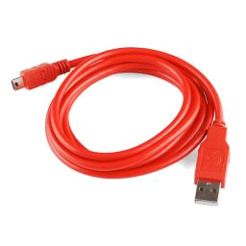
Go ahead and plug your board in!

Slide 4
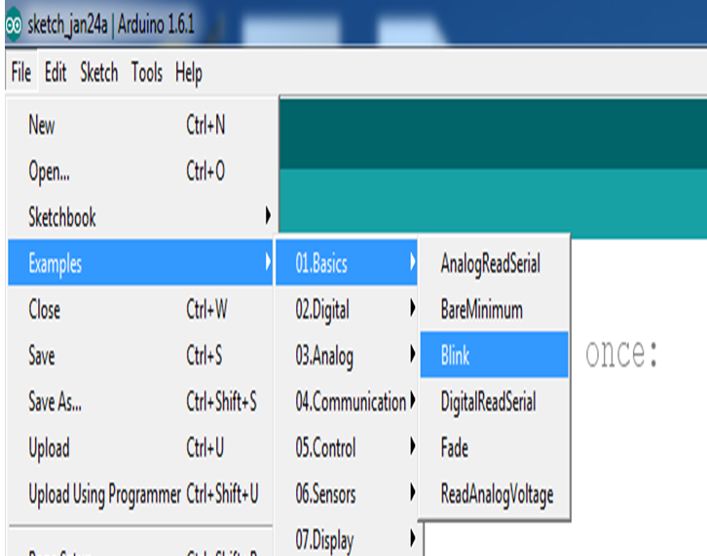
Is Alive Or Dead ?
Goto File -> Examples -> Basics -> Blink

Slide 5
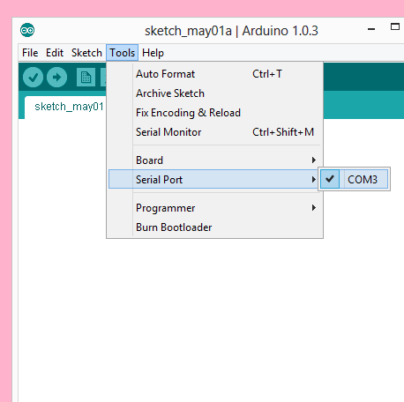
Settings: Tools → Serial Port
Your computer communicates to the Arduino microcontroller via a serial port → through a USB-Serial adapter.
Check to make sure that the drivers are properly installed.
Notes:
5
All connections to computers- mice, printers etc use a serial port. Gotta pick the right one.

Slide 6
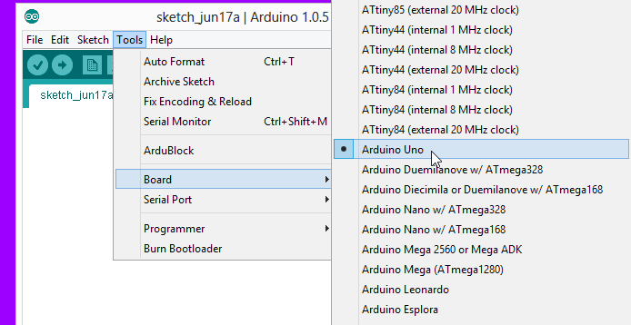
Settings: Tools → Board
Next, double-check that the proper board is selected under the Tools→Board menu.
Notes:
6
All connections to computers- mice, printers etc use a serial port. Gotta pick the right one.

Slide 7
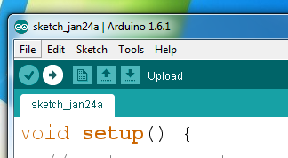
Verify

Slide 8
Upload

Slide 9
Upload it …..

Slide 10
Upload it …..

Slide 11
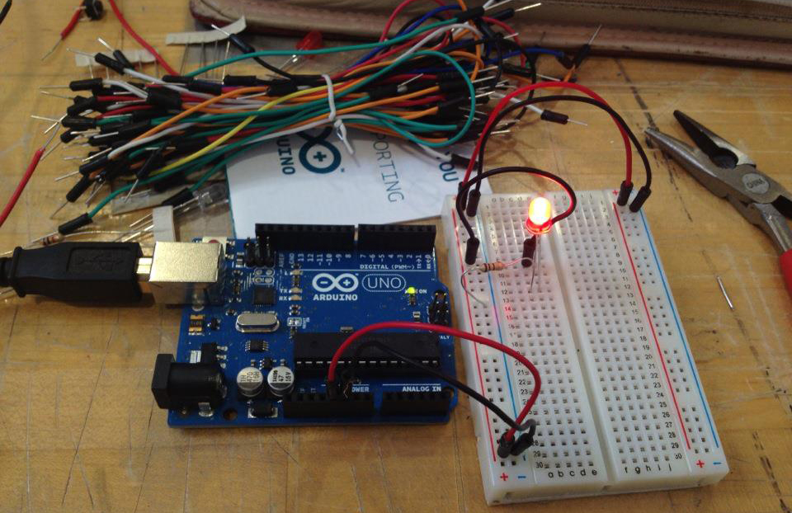
Getting Started…

Slide 12

Concepts: INPUT vs. OUTPUT
Inputs is a signal / information going into the board.
Output is any signal exiting the board.
Notes:
12

Slide 13
Concepts: INPUT vs. OUTPUT
Inputs is a signal / information going into the board.
Output is any signal exiting the board.
Examples: Buttons Switches, Light Sensors, Flex Sensors, Humidity Sensors, Temperature Sensors…
Examples: LEDs, DC motor, servo motor, a piezo buzzer, relay, an RGB LED
Notes:
13

Slide 14
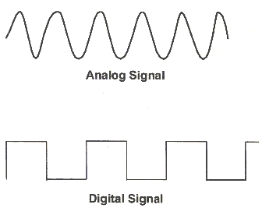
Concepts: Analog vs. Digital
Microcontrollers are digital devices – ON or OFF. Also called – discrete.
analog signals are anything that can be a full range of values. What are some examples? More on this later…
5 V
5 V
0 V
0 V
Notes:
14

Slide 15
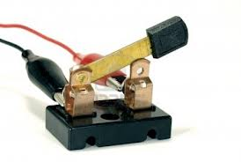
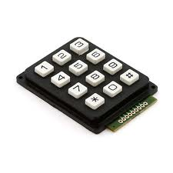
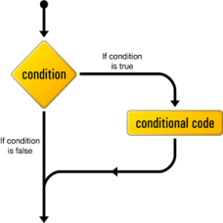
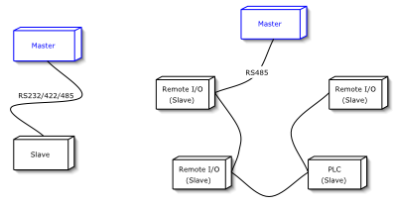
pinMode()
digitalWrite()
BIG 5 CONCEPTS
digitalRead()
if() statements / Boolean
Serial communication

Slide 16
Project 1
Blinking an LED

Slide 17
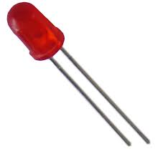
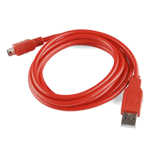
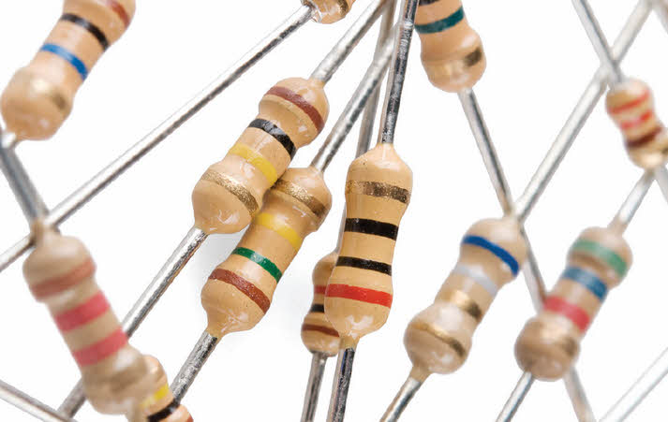
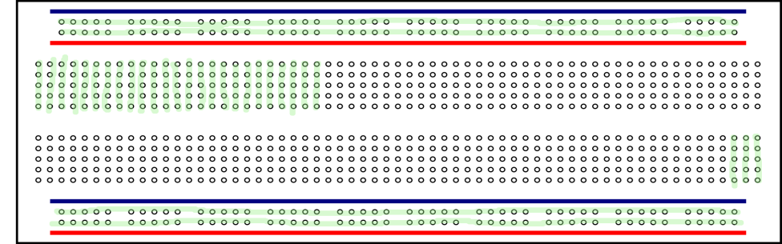
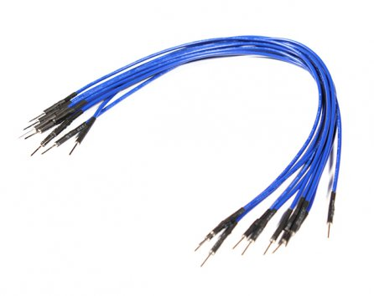
Ingredients

Slide 18
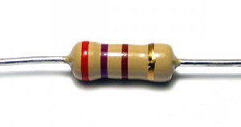
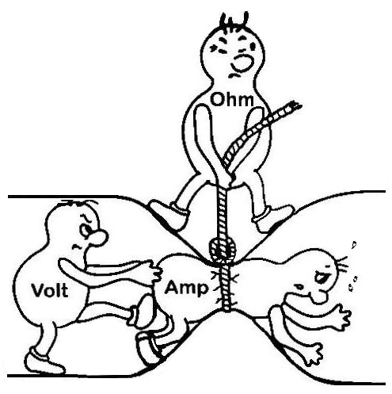
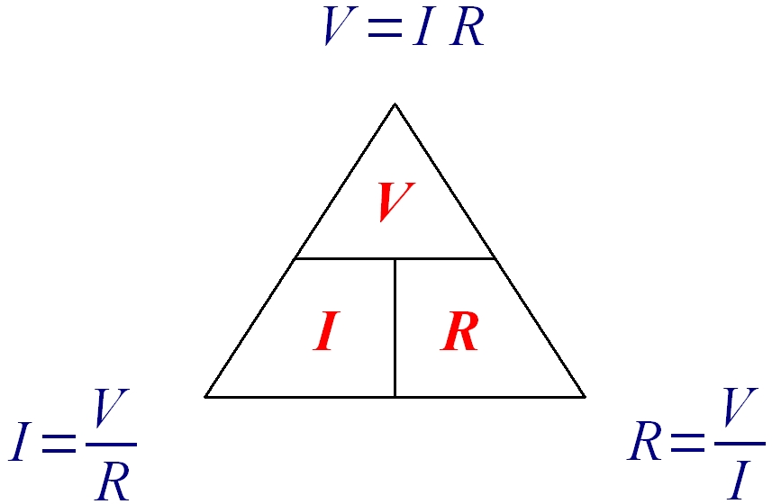
What is resistor?
Which oppose the electrons
Why we are using resistor?
Ohms law

Slide 19
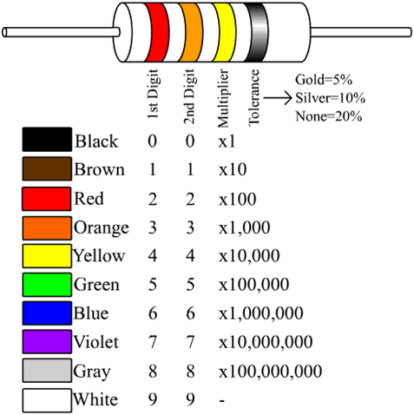
Calculation of resistance using color code
Calculation for resistor
1st Digit red color=2
2nd Digit orange=3
3rd Multiplier = 1x10000
total=23000 ohms

Slide 20
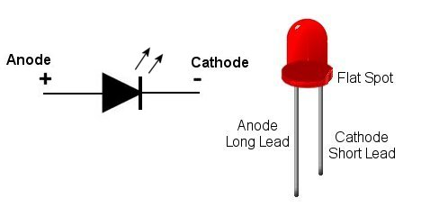
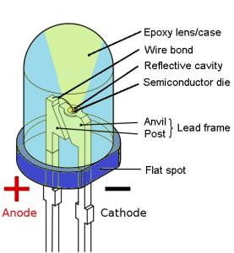
What mean by led?

Slide 21
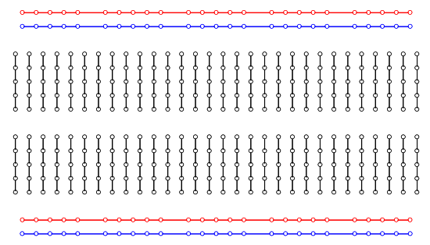
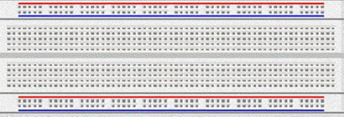
What is breadboard ?
How bread broad consists internal printed circuit ?

Slide 22
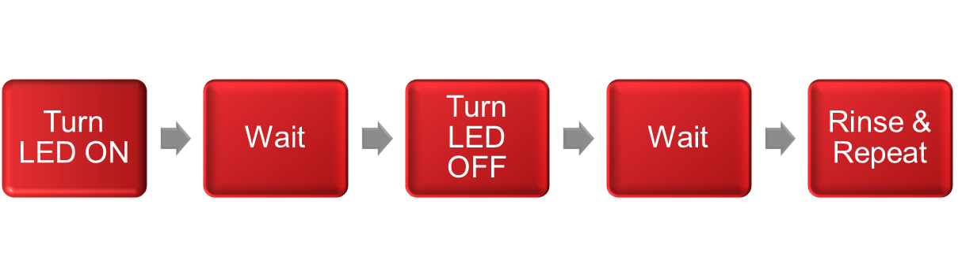
How Should This Work….
Blink led light

Slide 23
Functions Used
pinMode()
digitalWrite()
Delay()

Slide 24
Delay()
Pauses the program for the amount of time (in miliseconds) specified as parameter
Syntax : delay(ms)
Parameters : ms -> the number of milliseconds to pause

Slide 25
pinMode()
Configures the specified pin to behave either as an input or an output
Syntax : pinMode(pin, mode)
Parameters:
pin -> the number of the pin whose mode you wish to set
mode -> INPUT or OUTPUT

Slide 26
digitalWrite()
Write a HIGH or a LOW value to a digital pin
Syntax : digitalWrite(pin, value)
Parameters
pin: the pin number
value: HIGH or LOW

Slide 27
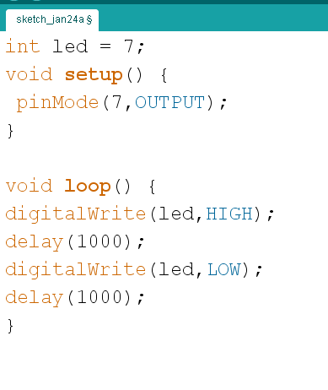
code

Slide 28
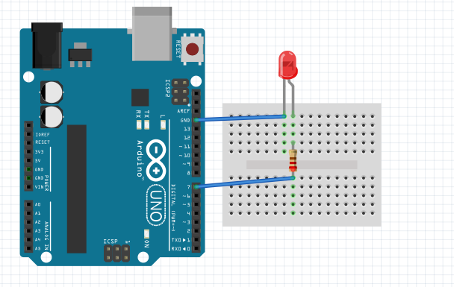
Wiring Diagram

Slide 29
Tutorial 2 : How Fast You Can Blink it?
Change the Delay Value to Minimum So you can Recognize the Blinking Pattern....

Slide 30
Fancy Blinking
Connect the 3 LED's to the Arduino

Slide 31
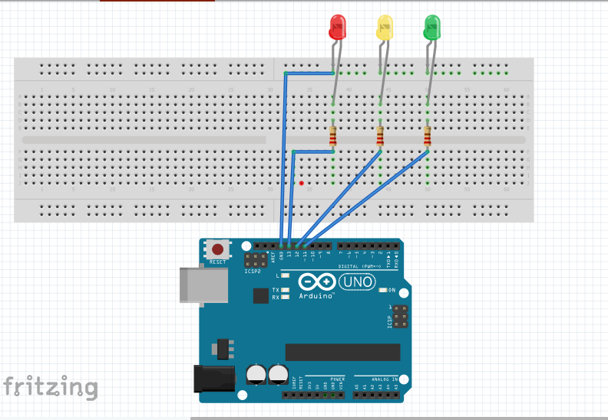
Wiring Diagram

Slide 32
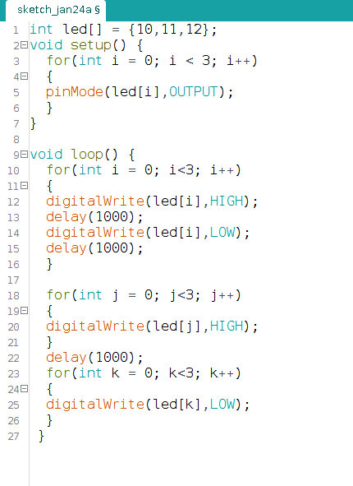
Code

Slide 33
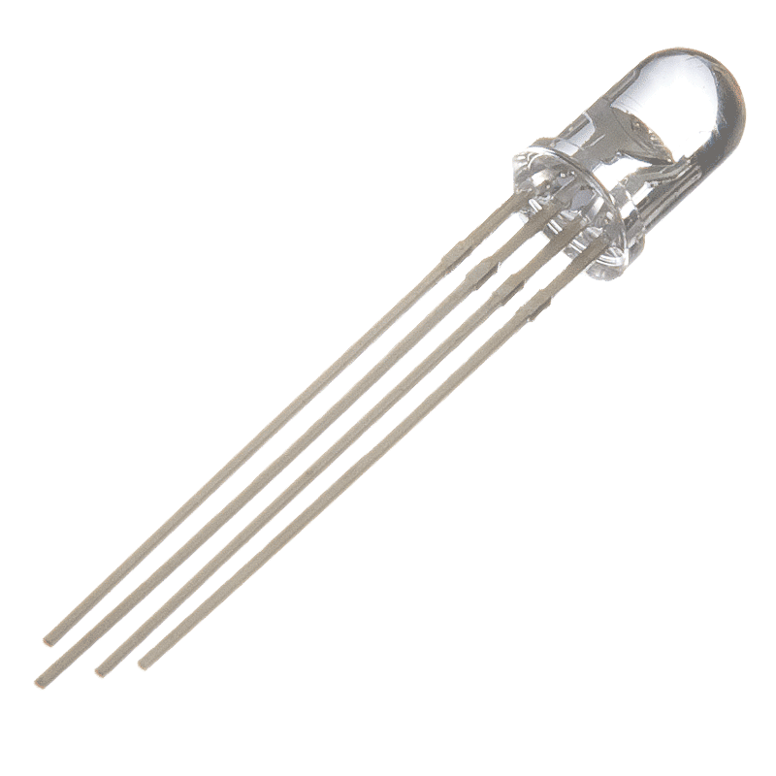
Project 2
Blinking an RGB

Slide 34
Ingredients

Slide 35
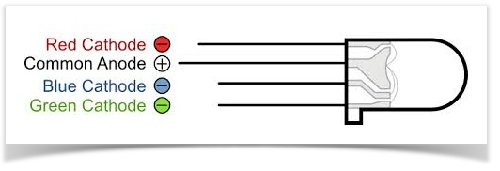
What is RGB LED ?

Slide 36
Code

Slide 37
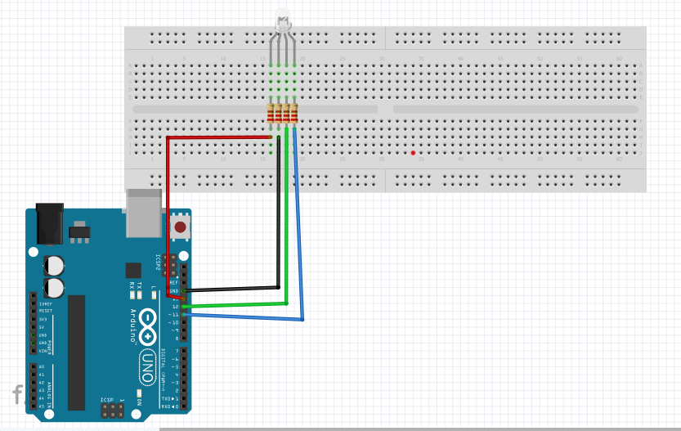

Slide 38
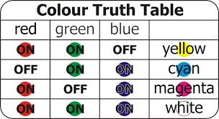
Task for you

Slide 39
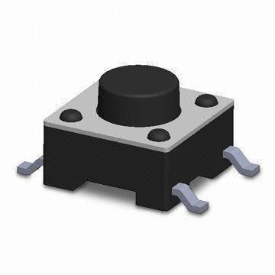
Project 3
Button press

Slide 40
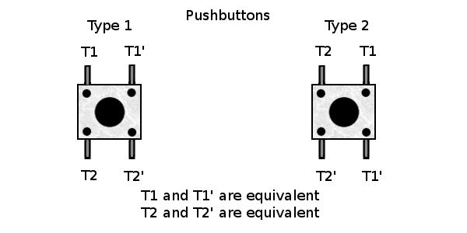
What is button?

Slide 41
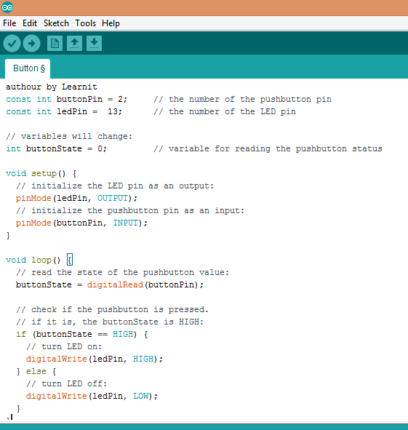

Slide 42
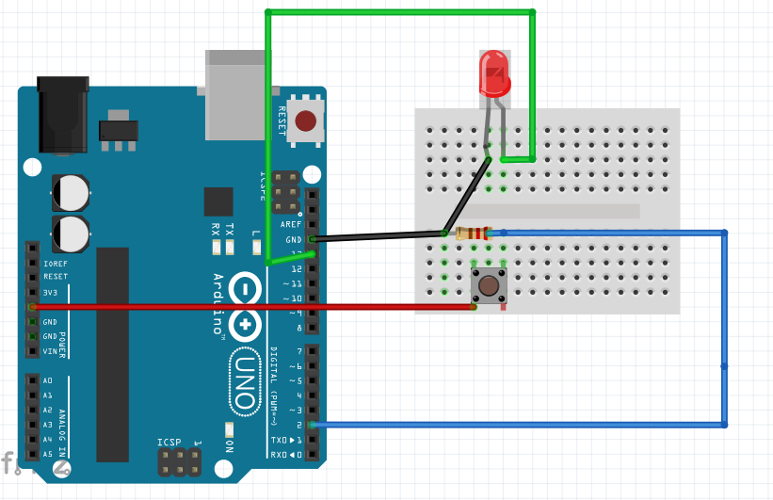

Slide 43
Project 4
De bounce

Slide 44
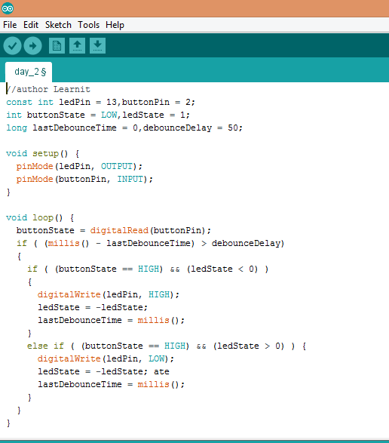

Slide 46
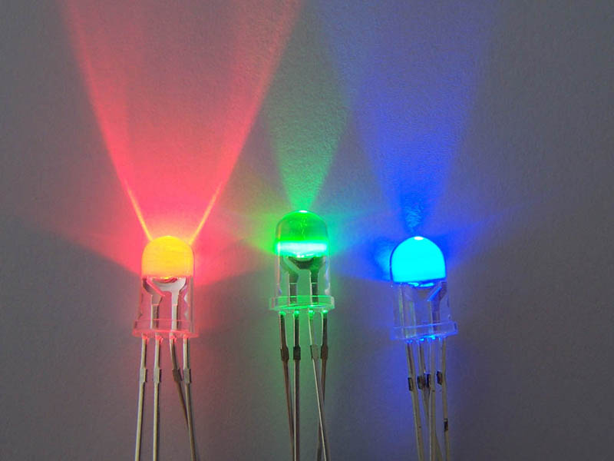
Concepts: PWM

Slide 47
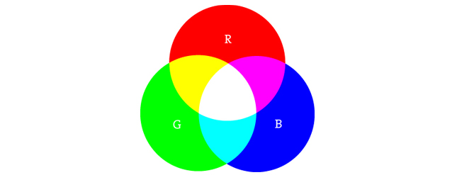
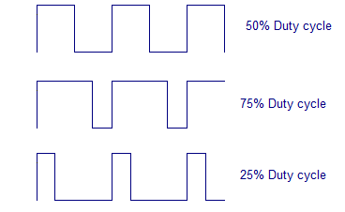
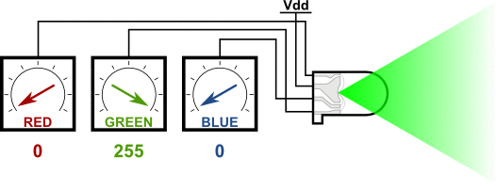
What is PWM?

Slide 48
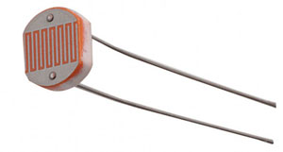
Project 5
De bounce

Slide 49
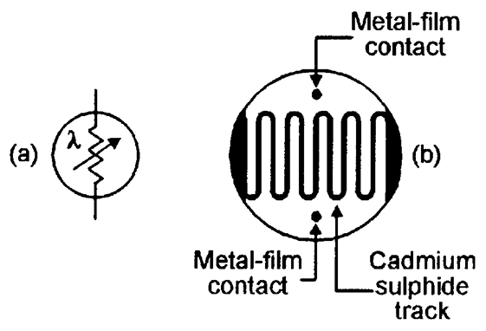
What is photo resistor?

Slide 50
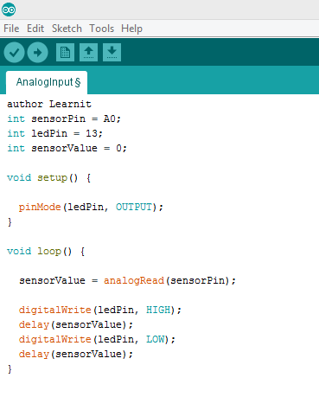

Slide 51
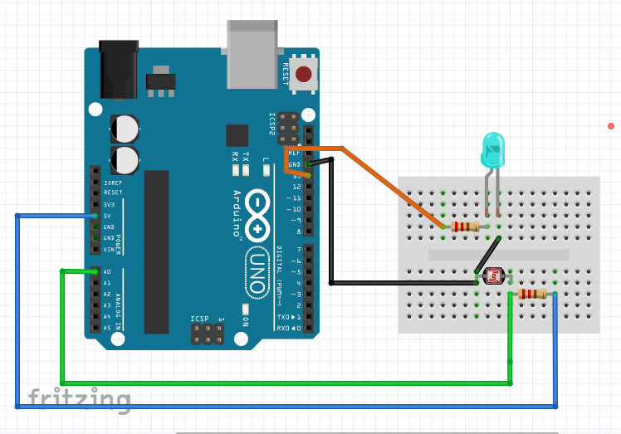

Slide 52
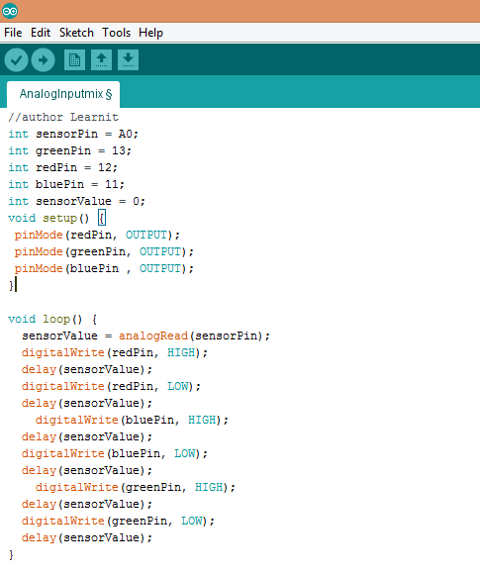

Slide 53
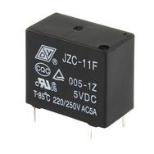

Digital Output – Controling any Electrical Device with any power needs using a relay
Externally Powered Device
Externally Powered Device
External Power 3v-220v
// Connect to Pin 13 and Ground
void setup(){
pinMode(13, OUTPUT); // Specify Arduino Pin number and output/input mode
}
void loop(){
digitalWrite(13, HIGH); // Turn on Pin 13 sending a HIGH Signal
delay(1000); // Wait for one second
digitalWrite(13, LOW); // Turn off Pin 13 sending a LOW Signal
delay(3000); // Wait for Three second
}
GRD
Control Pin

Slide 54
Digital Input
Adding Human – Arduino Interface
Ex : Keyboards

Slide 55


Input
Input is any signal entering an electrical system .
Both digital and analog sensors are forms of input
Input can also take many other forms: Keyboards, a mouse, infrared sensors, biometric sensors, or just plain voltage from a circuit
Notes:
55

Slide 56


Digital Sensors (a.k.a. Switches) Pull-up Resistor (circuit)
to Digital Pin 2

Slide 57


Digital Sensors (a.k.a. Switches) Add an indicator LED to Pin 13
This is just like our 1st circuit!

Slide 58
Commands Used..
PinMode()
digitalRead()

Slide 59
digitalRead()
It Reads the Digital Input
Syntax : digitalRead(pin)
Parameters : Pin -> pin Number
Returns : The Digital Read Value HIGH or low

Slide 60

Code

Slide 61

Denouncing

Slide 62
Debugging
Observability
Controllability
Serial Communcation is One of Debugging Interface of Arduino

Slide 63



Using Serial Communication
Method used to transfer data between two devices.
Data passes between the computer and Arduino through the USB cable. Data is transmitted as zeros (‘0’) and ones (‘1’) sequentially.
Arduino dedicates Digital I/O pin # 0 to receiving and Digital I/O pin #1 to transmit.
Notes:
63
For this reason, we typically do not use Digital I/O 0 or 1 for anything in our designs.

Slide 64
Serial Communication
Serial Communication is the transferring and receiving of information between two machines, the Arduino dedicates pin # 0 to receiving information and pin 1 to transferring information

Slide 65

Serial in Setup

Slide 66

Serial Monitor

Slide 67

Serial Monitor

Slide 68

Serial Communication

Slide 69

Serial Activity with Circuit 7
Communication
Troubleshooting circuits
Debugging Code

Slide 70
Serial Communication: Serial Setup
void setup ( ) {
Serial.begin ( 9600 ) ;
}
In this case the number 9600 is the baudrate at which the computer and Arduino communicate

Slide 71
Serial Communication: Sending a Message
void loop ( ) {
Serial.print ( “Electronics& “ ) ;
Serial.println ( “Mechatronics” ) ;
}

Slide 72
Serial Communication: Serial Debugging
void loop ( ) {
int xVar = 10 ;
Serial.print ( “Variable xVar is “ ) ;
Serial.println ( xVar ) ;
}

Slide 73
Serial Communication: Serial Troubleshooting
void loop ( ) {
Serial.print ( “Digital pin 9 reads “ ) ;
Serial.println ( digitalRead ( 9 ) ) ;
}

Slide 74
Functions in Serial Library
Serial.available()
Serial.begin()
Serial.println()
Serial.print()
Serial.read()
Serial.parseInt();

Slide 75
Do Some More….
Control the LED via Serial
Read the Button State using Serial

